Slide 1
PHASE 2 PROJECT
ANTHONY GITHINJI NGATIA
DSPT-02

Slide 2
Business Problem
The project is for a real estate agency that helps homeowners buy and/or sell homes.
The goals of the project are to use regression modeling to analyze house sales in a northwestern county and advice homeowners about the variables affecting the pricing of houses.

Slide 3
Data Cleaning and Preprocessing
The steps taken to prepare the data for analysis were:
Loading the kc_house_data.csv dataset.
Dropping the columns that are redundant and not required for the analysis.
Checking for and imputing null values, checking for duplicated entries and dropping them.
Normalising the dataset to have values ranging from 0-1.

Slide 4
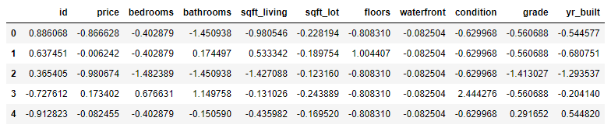
A snippet of the cleaned dataset is displayed below:

Slide 5
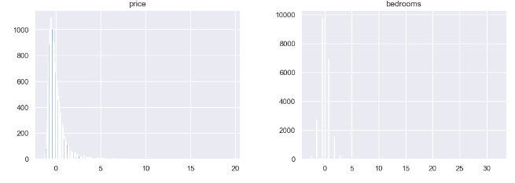
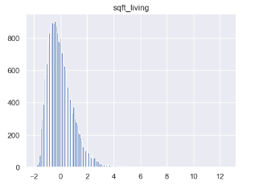
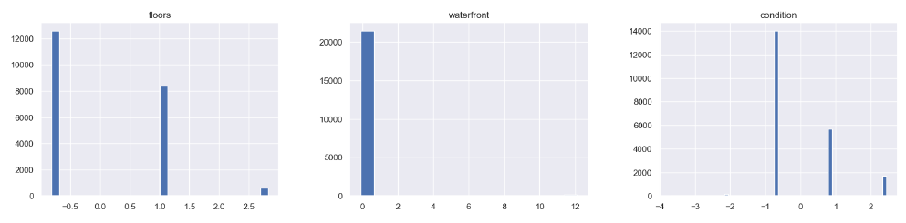
Performing a Linear Regression of the data we were able to visualize the normal distribution of the data.

Slide 6
Observations
The price and sqft living have a distribution that could approximate a normal distribution.
The sqft_living, sqft-lot, price and bathrooms have continous data whereas grade, condition, waterfront and floors have discrete data.
Most houses are graded with a condition scaled at 3/5 with almost 14000 houses having a grade of 3 and the least houses < 2000 have a condition that is graded 5.
Most houses have a single floor and the least houses have 3 floors.
There is an increase in the total houses built from the year 1900- 2000 where there was a drop in the number of houses built. However, the number has started to increase from 2010 to 2020.

Slide 7
Results and Conclusions
There is a correlation between the square ft living area, footage of the lot and the price of the houses.
Most houses have a 1 and 1/2 bathrooms.
The average sqft_living area is approximately 900 square metres with an average price of 100000.
Houses with a larger living area, have a higher purchase price but the number is low, indicating lower demand compared to the less expensive houses.
All houses sampled in the dataset do not have a waterfront.

